Slide 1
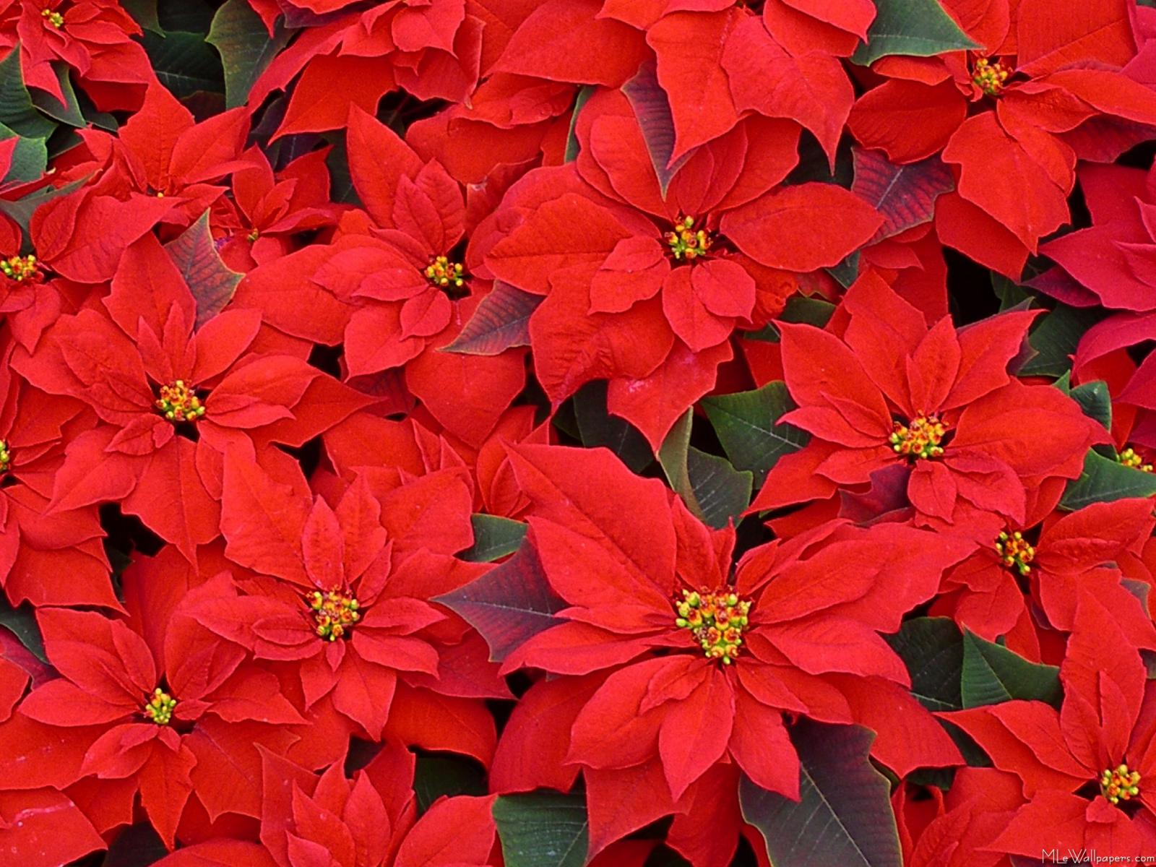
FRUIT AND FLOWER FUNDRAISER-2021
Leesville Road High School

Slide 2
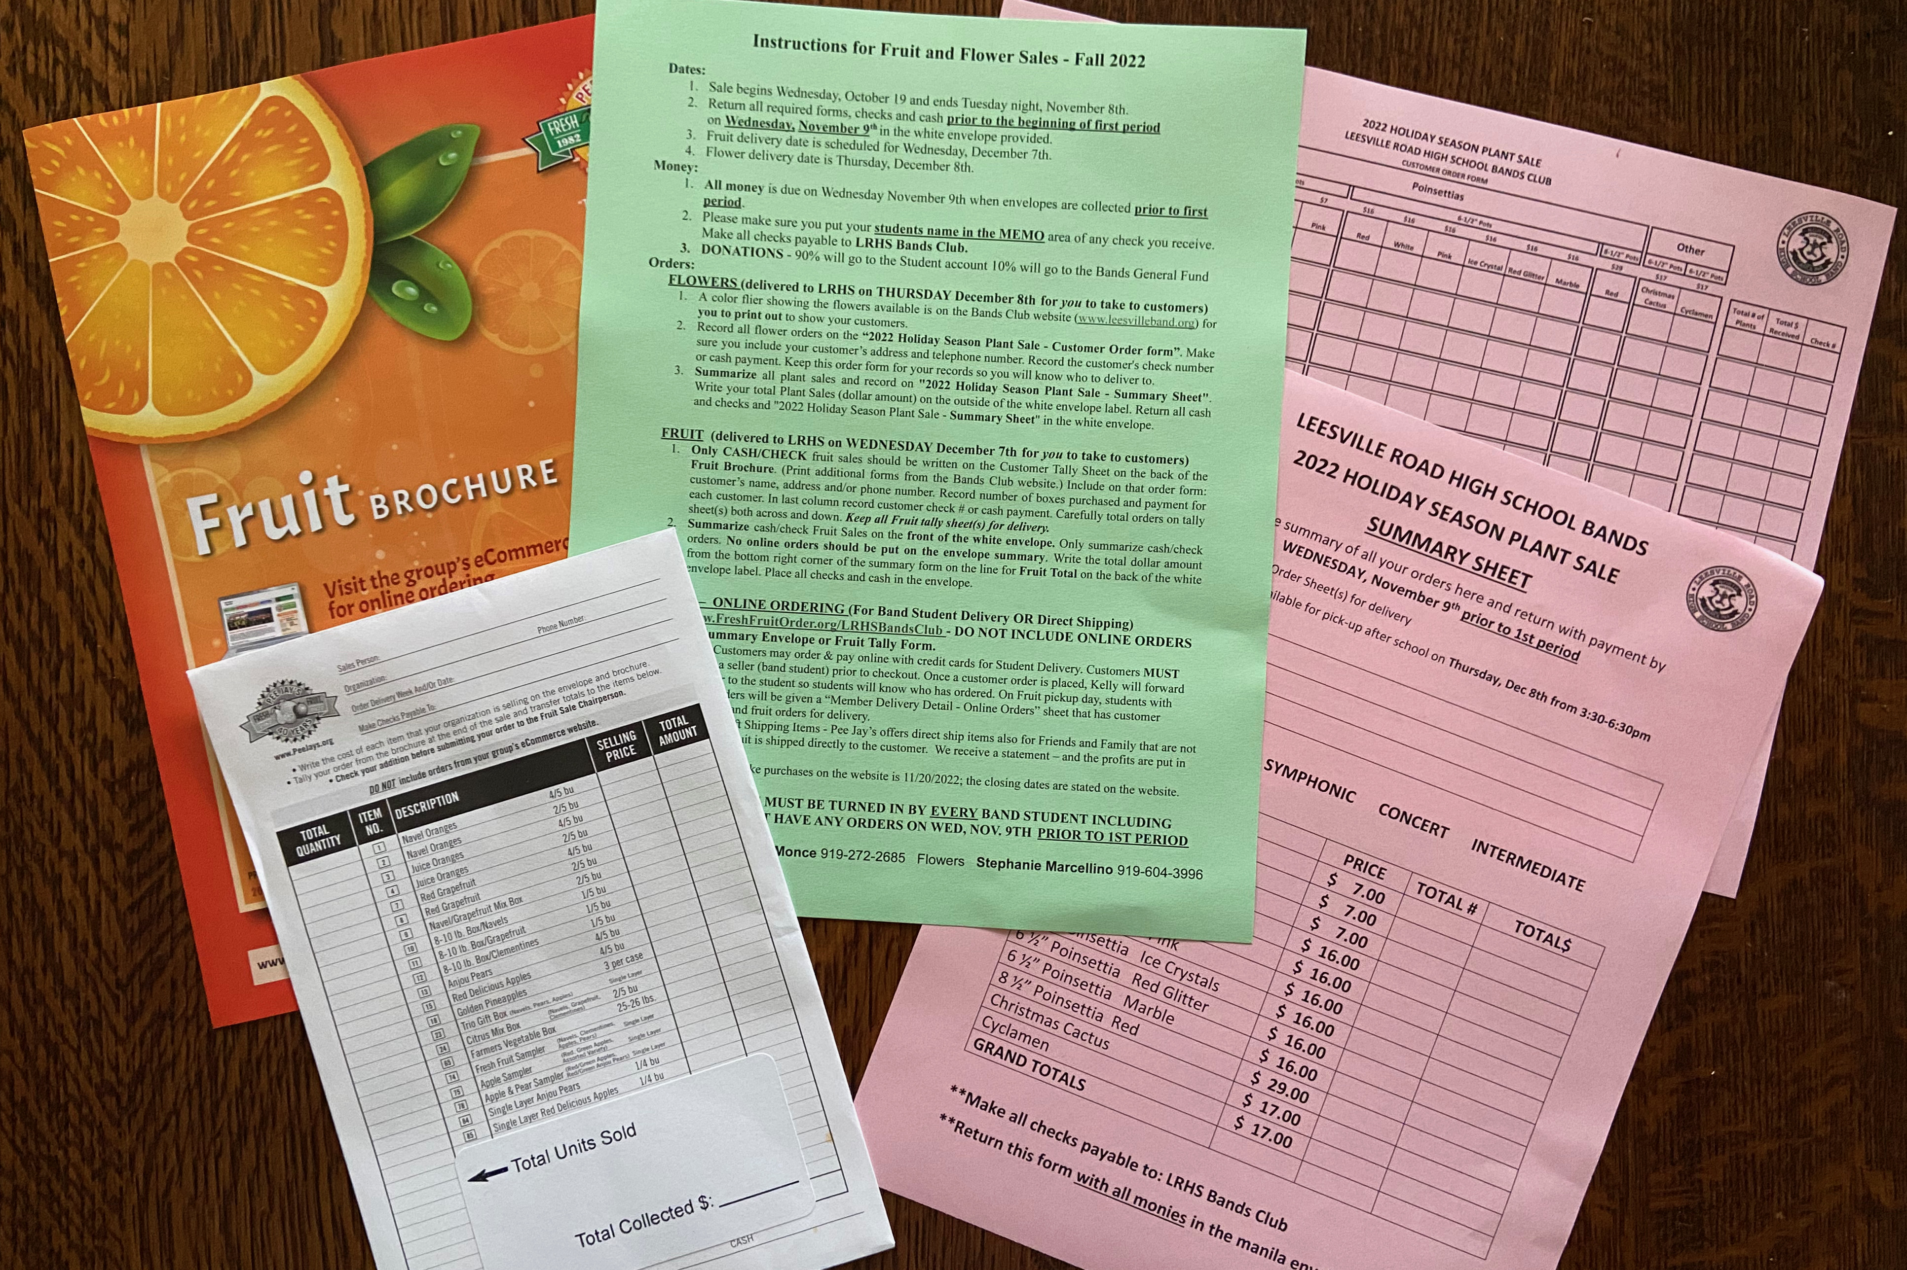
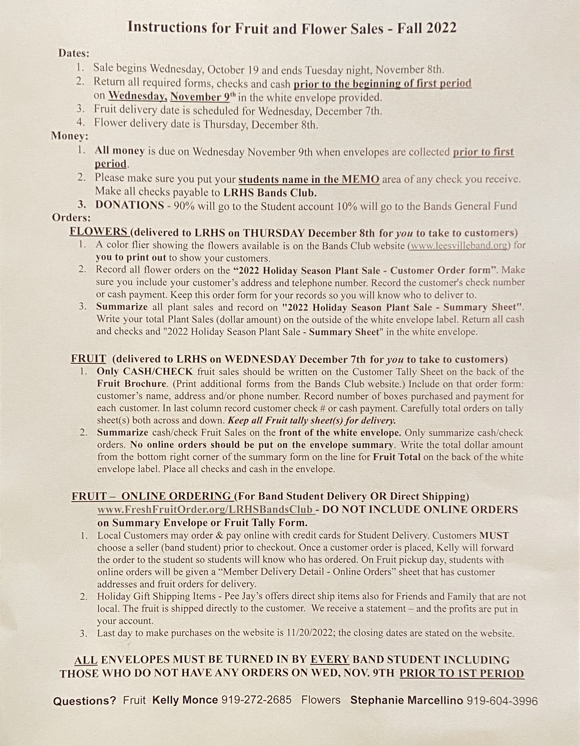
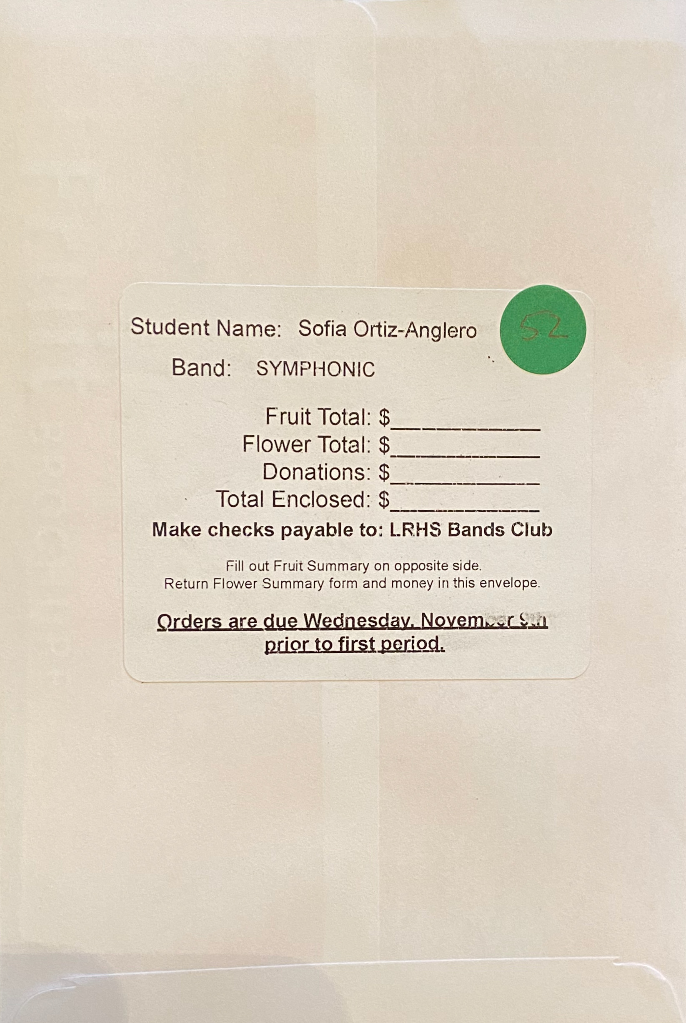
FRUIT AND FLOWERS FOLDER
Envelope:
Front
Fruit Summary
Back
Total Fundraising Summary
Envelope Contents
2 Pink Flower Sheets
1 Fruit Brochure
1 Green Instruction Sheet
INSTRUCTION SHEET

Slide 3
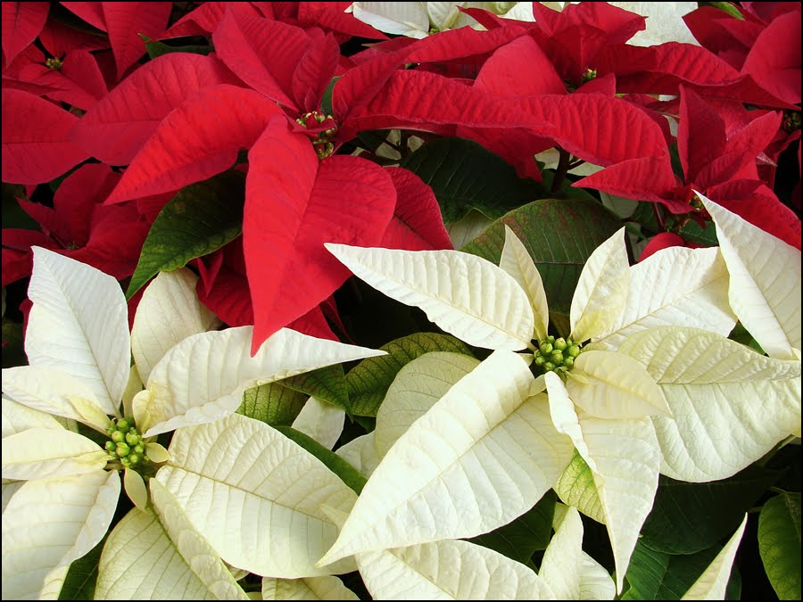
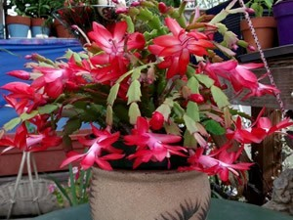
Fruit Delivery
Wednesday,
December 7th
Flower Delivery Thursday, December 8th

Slide 4
– FLOWER SALES
Profit on flower sales – 35 - 54%*
*A portion of the profits will go to the
General Bands Club Fund

Slide 5
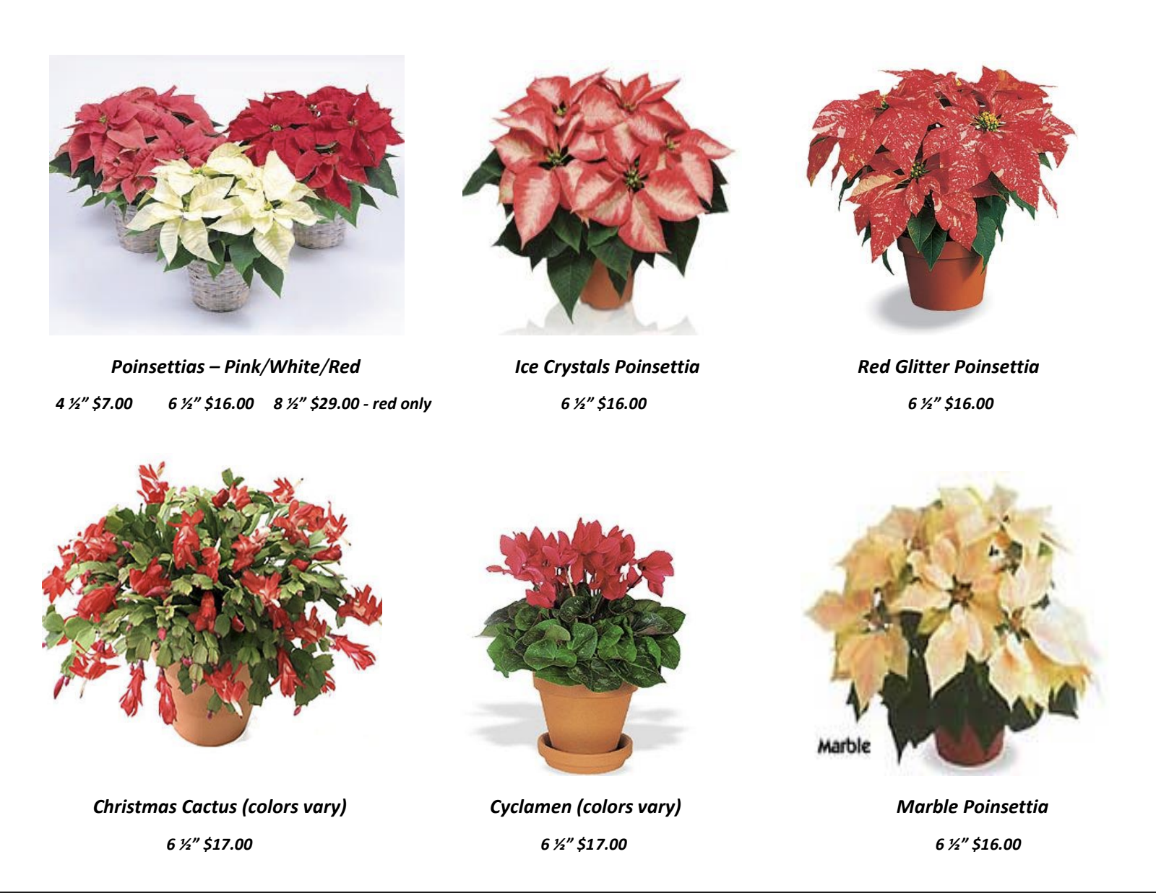
Flowers Picture Sheet
Student prints this picture sheet from the Band Website

Slide 6
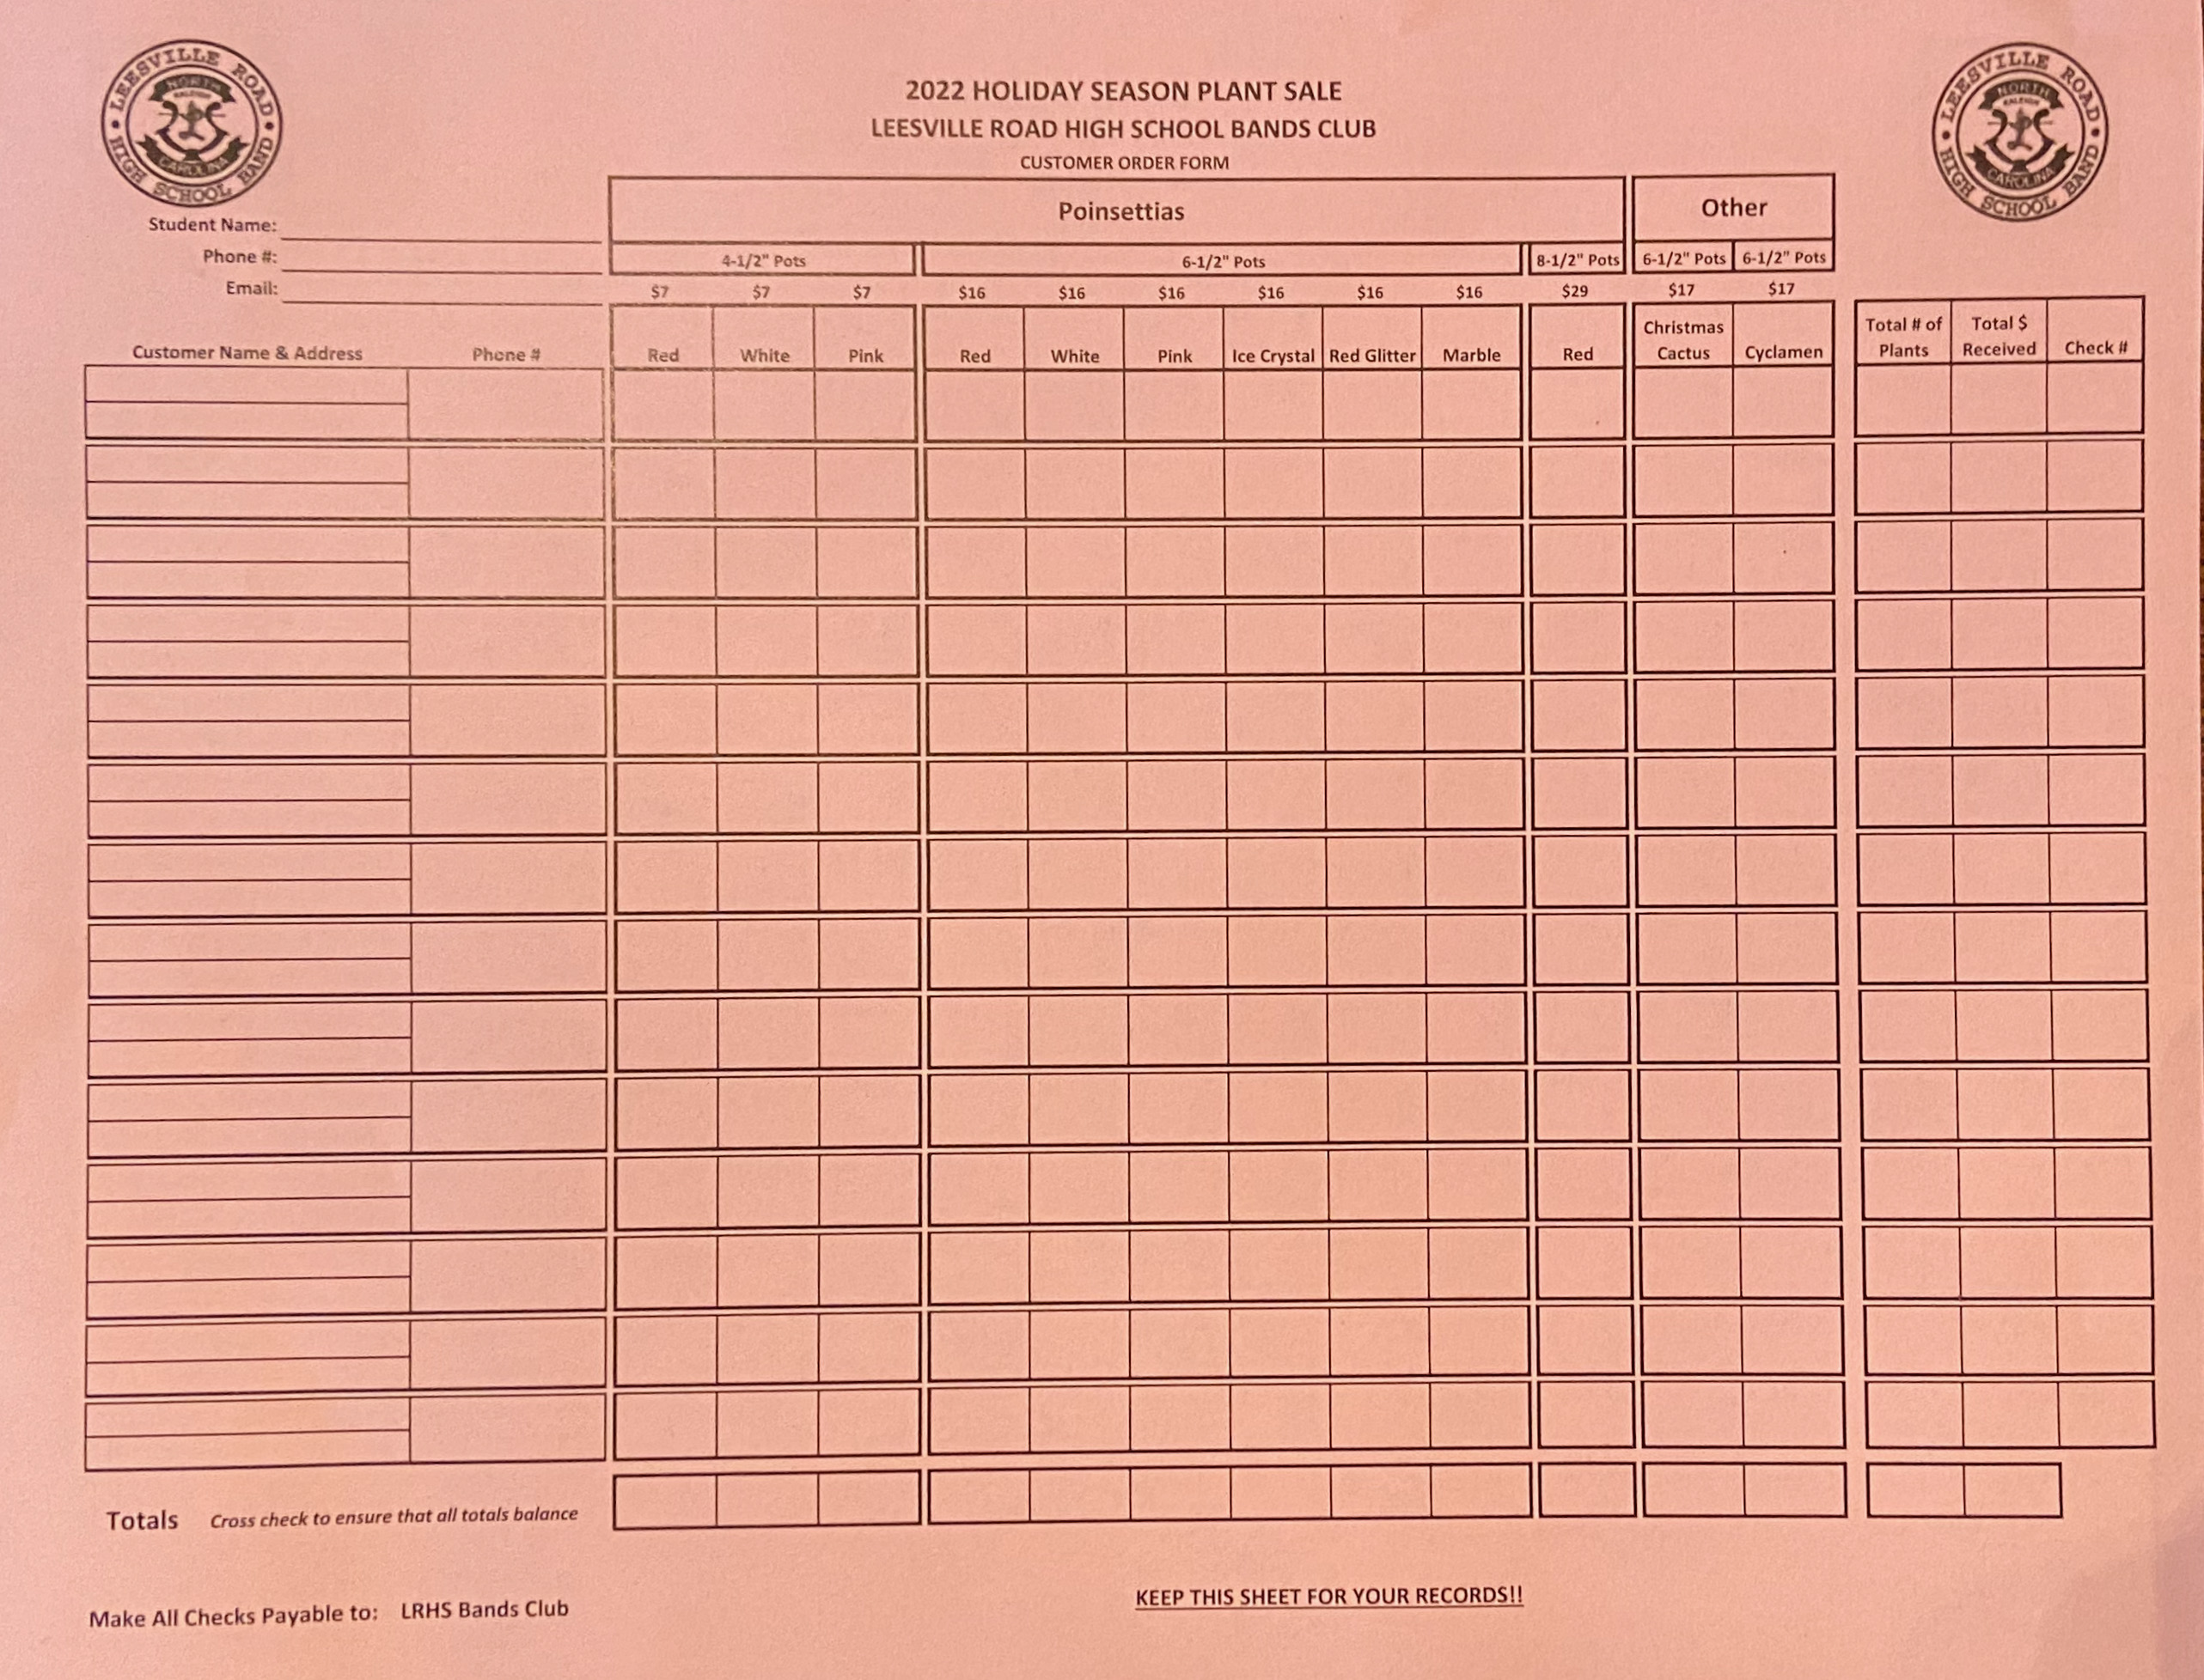
Flowers Order Form
Keep This Form For Your Records

Slide 7
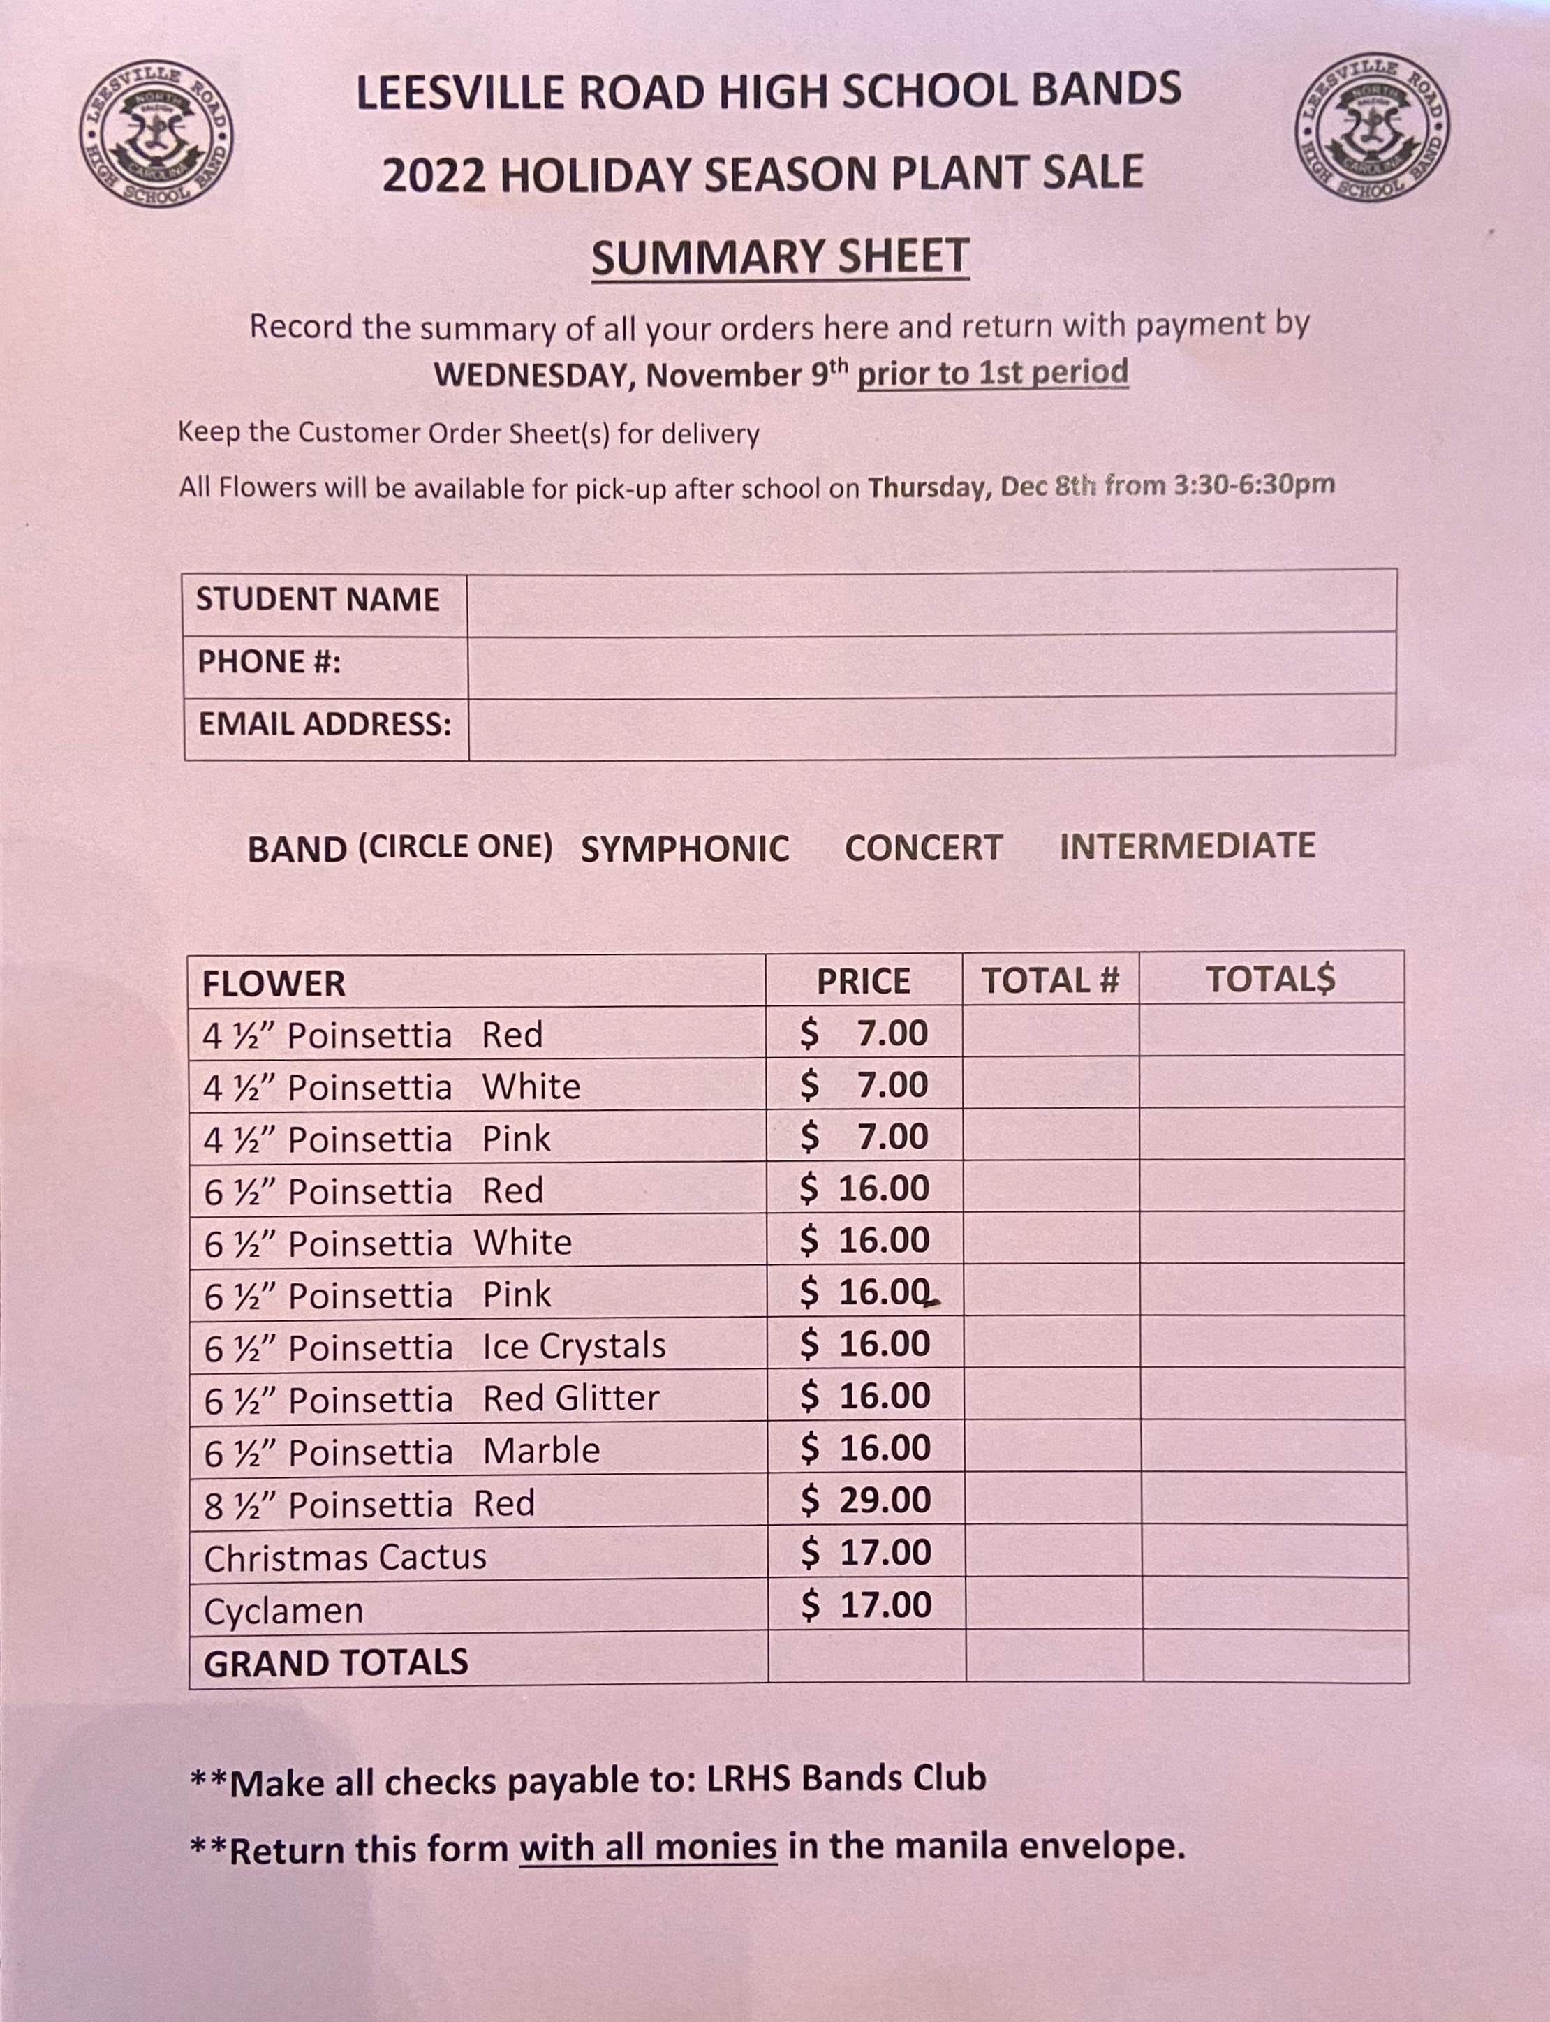
Flowers Summary Sheet
Turn in this form in the white envelope
This sheet is PINK

Slide 8
Flower $$$ Sold
Flowers will be
delivered to the
Engineering Room
at the school on
Thursday, Dec 8

Slide 9
FRUIT SALES Profit on Local Delivery Sales: approximately 40%* .
Profit on Direct Ship Gift Items:
$10.00 per box sold*
* A portion of the profits will go to the General Bands Club Fund

Slide 10
2 Ways to Sell
FRUIT !!

Slide 11
The First Way to Sell Fruit
LOCAL Delivery Sales:
Selling Door to Door
Check or Cash payments (no credit cards)
Ordering Online
Credit Card Only
www.freshfruitorder.org/LRHSBandsClub/

Slide 12
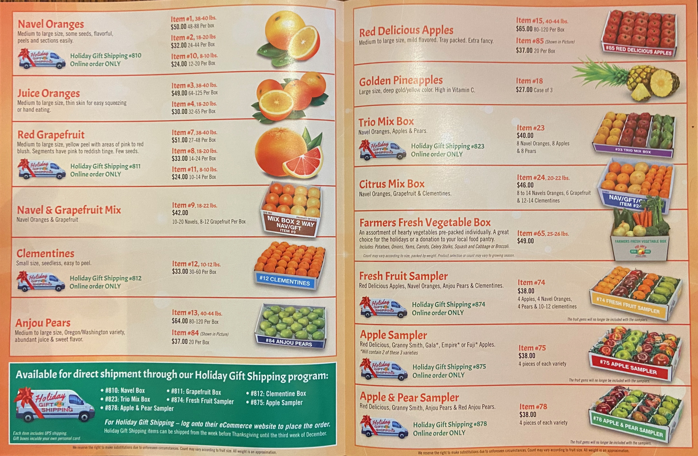
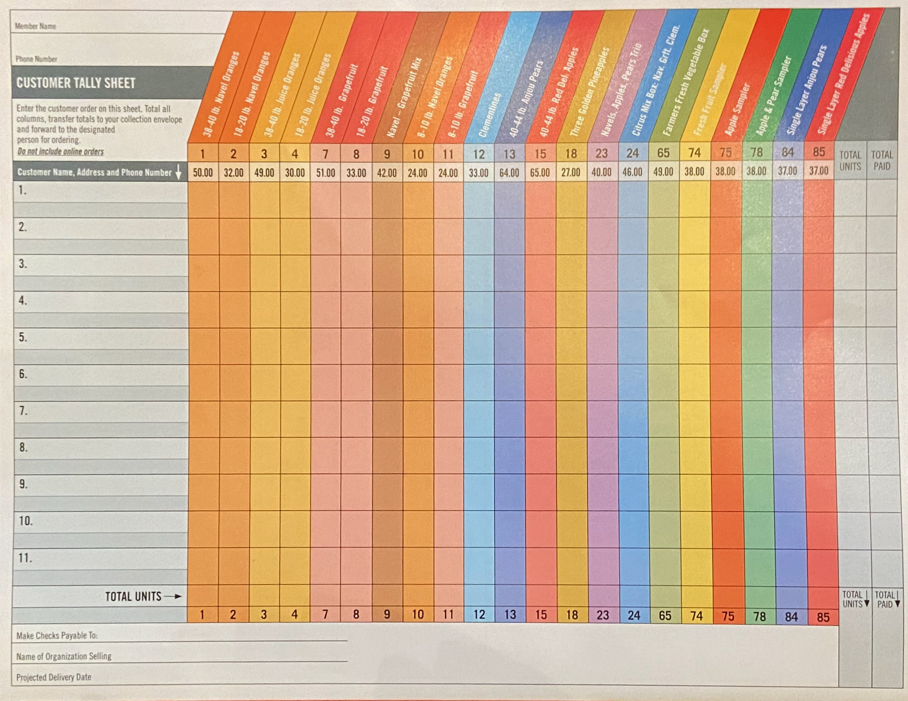
Local Delivery Fruit Ordering
Student takes order & collects cash or checks
2. Student delivers order
Total Each Order Across Row
Total each column for each fruit type
Keep This For Your Records

Slide 13
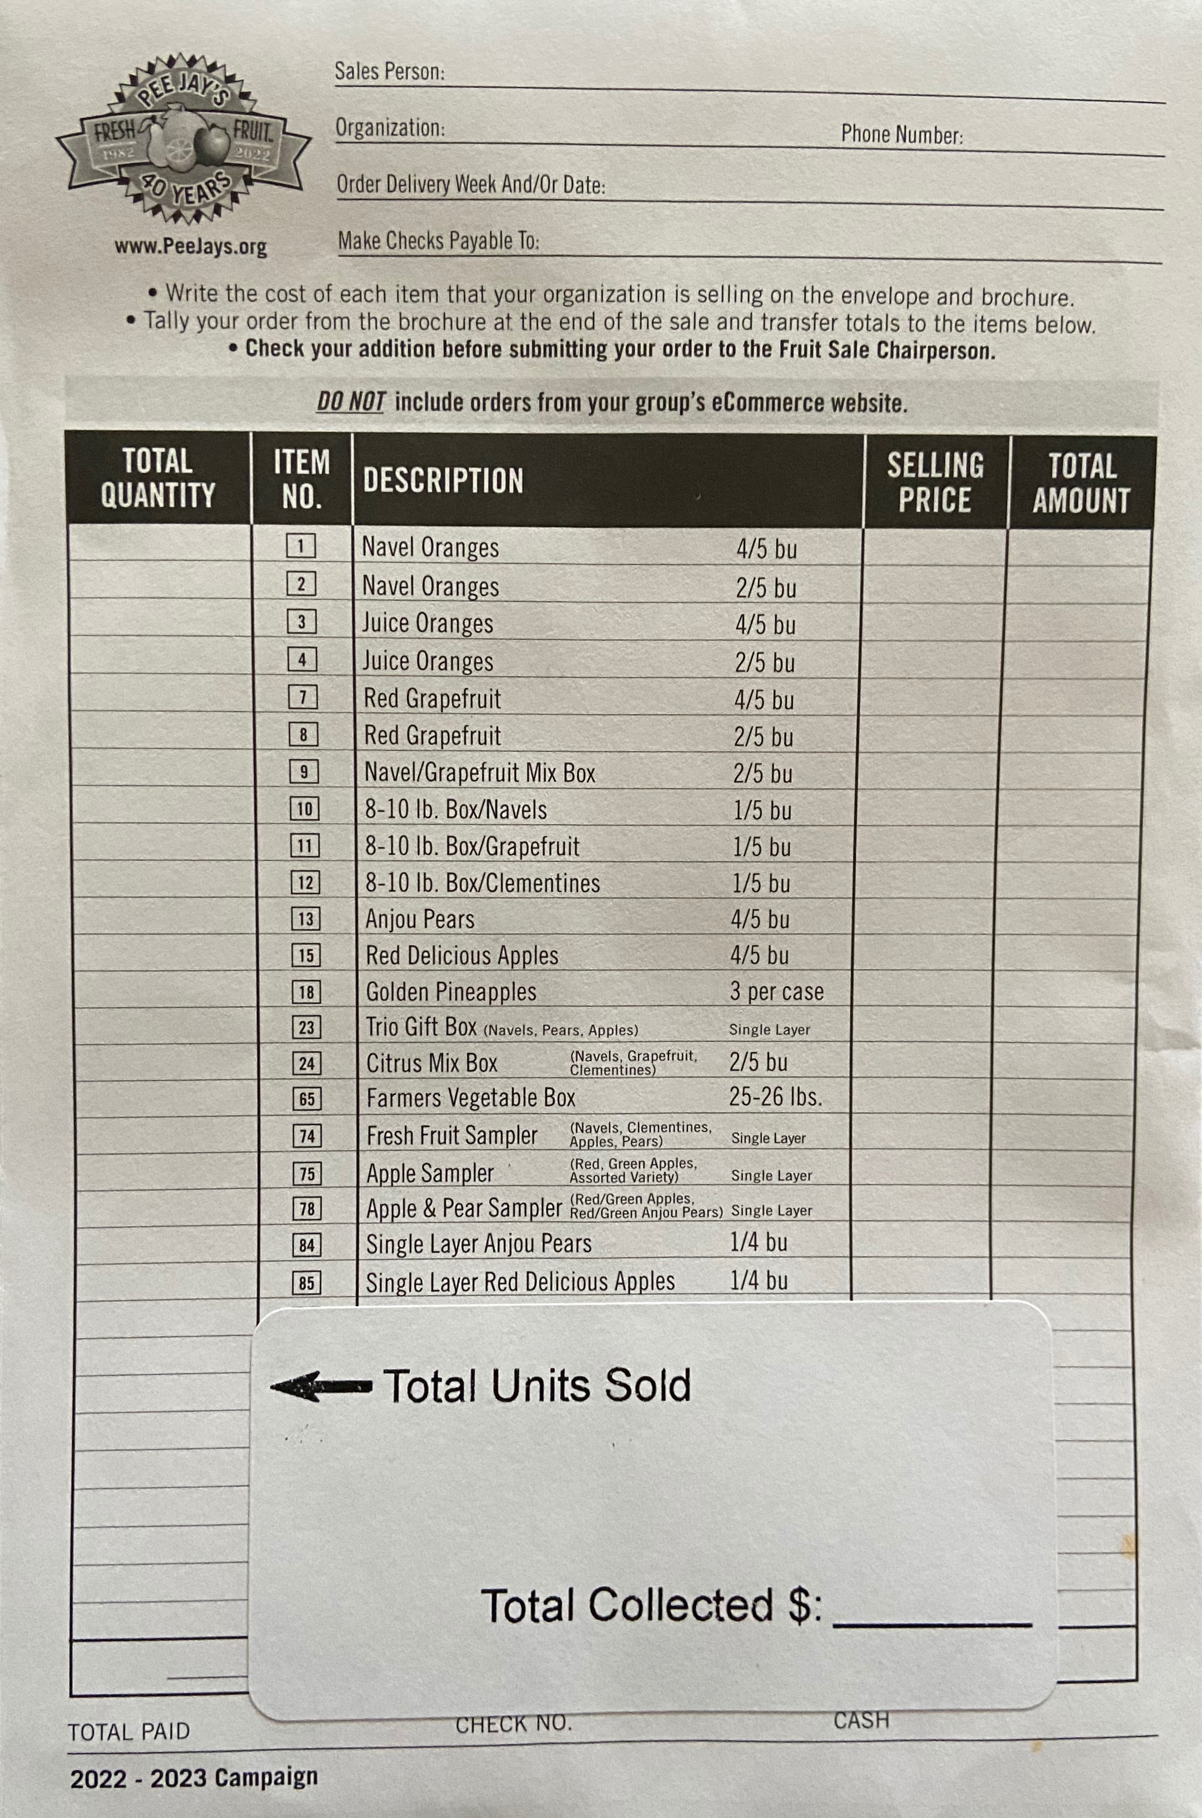
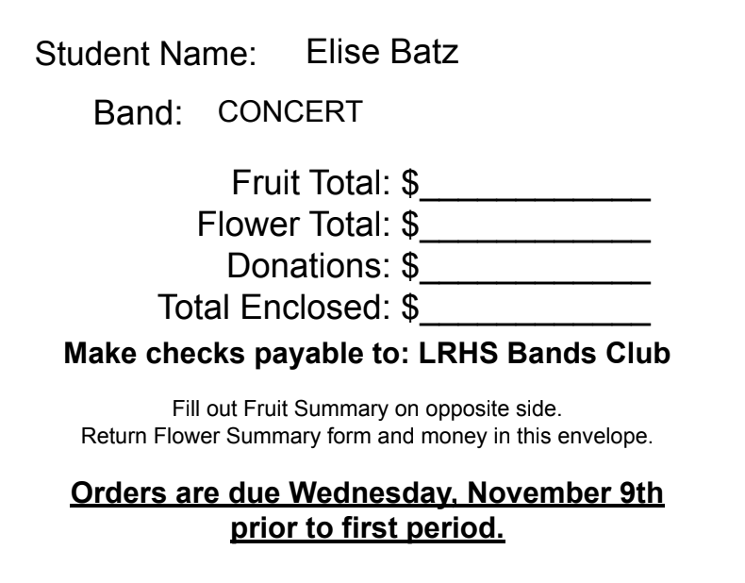
Fruit Sale Summary
(Cash and Check Orders Only)
Fill In
$50
$32
$49
$30
$51
$33
$42
$24
$24
$33
$64
$65
$27
$40
$46
$49
$38
$38
$38
$37
$37
Fruit Summary form is on the front of the envelope
Fruit will be delivered to the Engineering Room
on Wednesday, December 7th

Slide 14
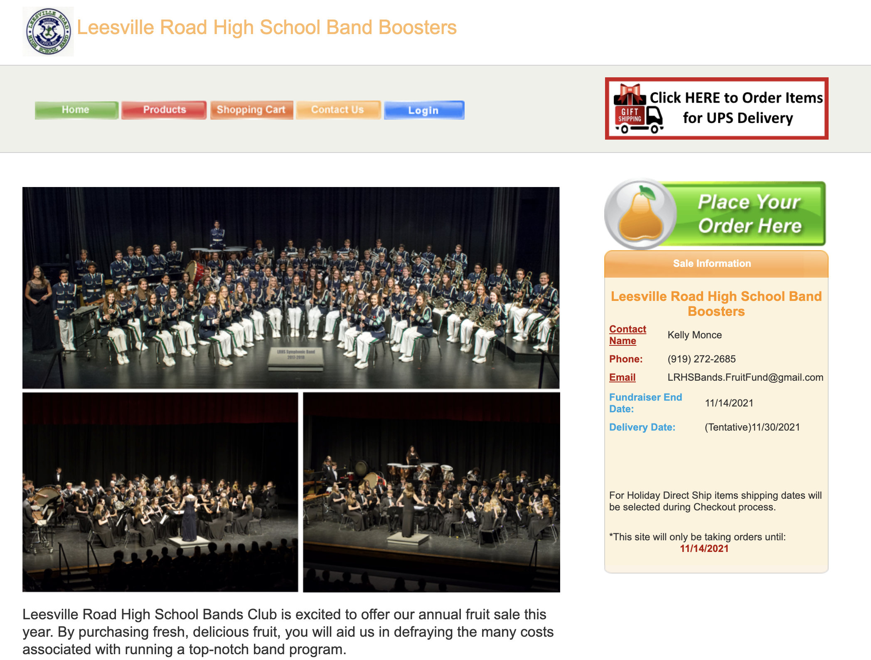
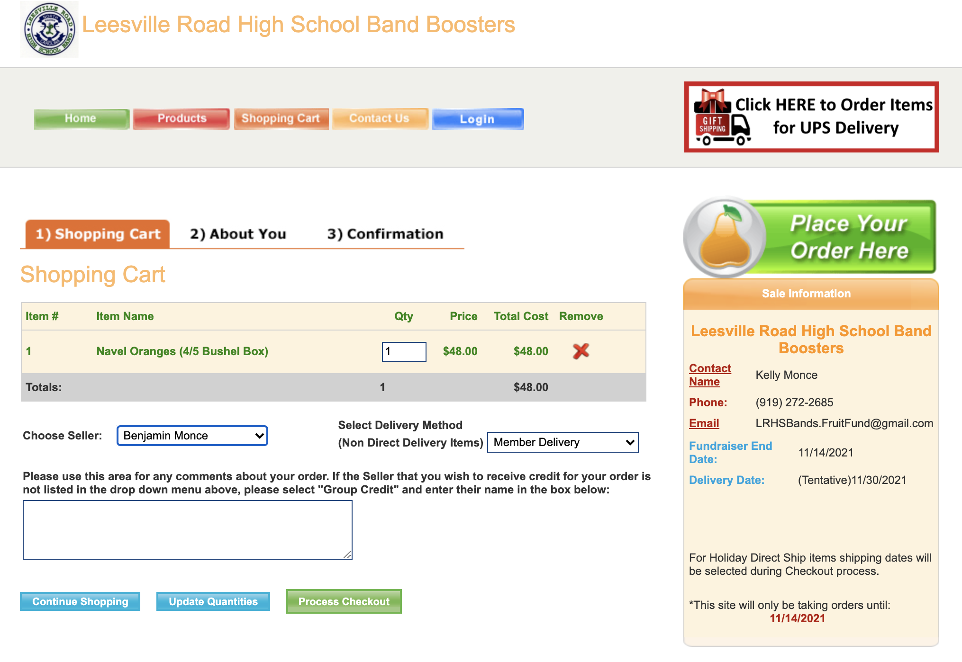
Online Ordering for Local Delivery
Go to www.freshfruitorder.org/LRHSBandsClub
Customers place orders online
Choose student name in shopping cart
Customer will enter local address for Member Delivery items in ‘About You’ section
Fruit Coordinator will forward order confirmation to student with delivery information

Slide 15
The Second Way to Sell Fruit
SHIPPING – Direct Delivery Items
Direct Ship – Continental US Only
Credit Card Payments Only
www.freshfruitorder.org/LRHSBandsClub/

Slide 16
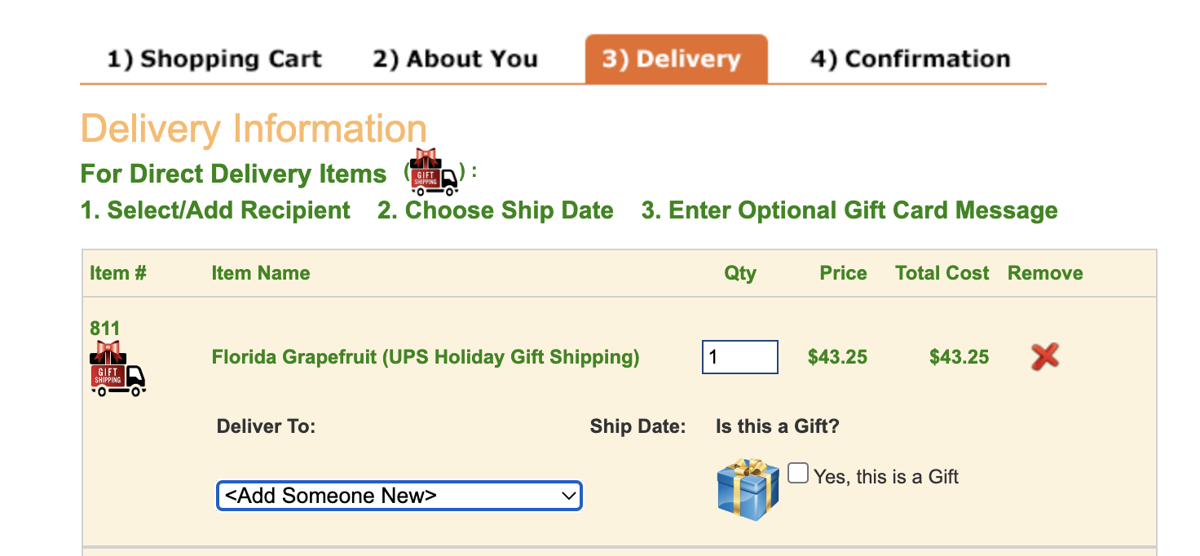
Direct Ship Online Ordering
Go to www.freshfruitorder.org/LRHSBandsClub
7 Different Gift Boxes to Select
Customer must Choose student name in Shopping Cart
Customer will enter Recipient address, Choose Ship Date and write Gift Card Message in the Delivery section
Orders are shipped directly to address provided by customer on the requested Date

Slide 17
Deadline for ALL STUDENTS to Return Orders & Empty Envelopes (no orders taken)
November 9th prior to 1st period
IN THE ENVELOPE:
Flower Summary sheet
All money (cash & checks)
ON THE ENVELOPE: ​
Fruit Summary sheet
Fruit, Flower, Donation & Total Collected ​
Remember all checks are payable to:
LRHS Bands Club

Slide 18
Fruit Delivery
Wednesday,
December 7th
Flower Delivery Thursday, December 8th

Slide 19
IMPORTANT QUESTION
When do profits from this sale go into my student’s band account?
Around mid- January, 2022
$$$ Donations!!!
*** 90% of the money collected by the student will go towards that student’s account ***
10% will go towards the band general fund

